Slide 1
Embeddable Reporting
Kimberly Pol

Slide 2
What is Emebeddable Reporting
Allows the IBM Cognos Business Intelligence Reports to run in a Bluemix environment.
Based on Cognos Business Intelligence version 10.2.2
Notes:
to further discuss why do we need a reporting service

Slide 3
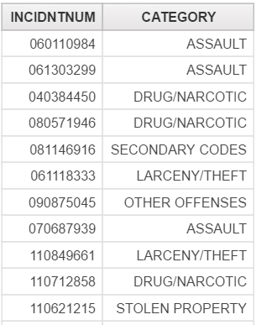
Sql statement to generate this report:
SELECT INCIDNTNUM, CATEGORY
FROM incidents
Notes:
If we want to generate this kind of table
We would have a sql statement like this: <sql statement in the slide>
But the problem with these kind of reports is that it does not make sense if about saan itong report, basta nagdump lang ng values in the database

Slide 4
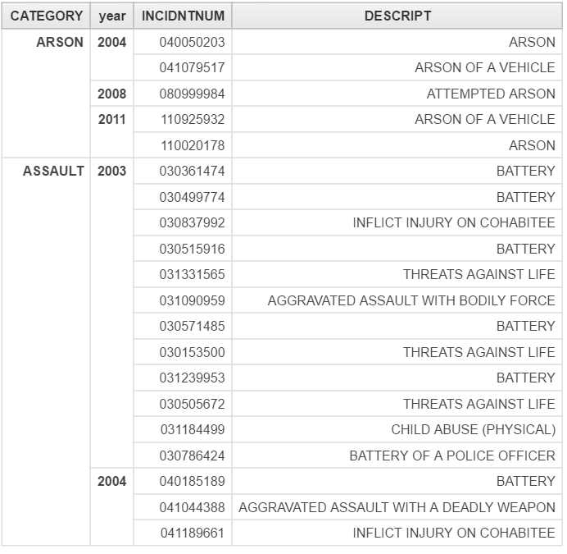
Notes:
The report is arrange by what category of a crime, year that it happened, incident number and description of the crime committed.
It is now more readable in a sense we can see that there are more assault than arson crimes being committed.
Now, If we think about how do we generate a reporting like this in a sql statement, it will be very complicated. Since aside from grouping it by category. Igroup pa by year of the committed category crime.

Slide 5
Services
dashDB
Database Service (use to store report data)
Data Source
Cloudant
Data Management Service (use to store report artifacts)
Connect Source
Embeddable Reporting
Reporting Service (runs the IBM Cognos Business Intelligence Reports)
Notes:
dashDB – is the database service that is used to store report data (relational database) – in the tutorial, this is the datasource used where a repository that holds the data to report.
Cloudant – is a data management service that is used to store report artifacts/metadata: report specifications and data source connections
- To avoid confusion with the cloudant service, in the tutorial we used this to add a NoSQL json style/ schemaless data
But the real purpose of this service, is this is where the report artifacts/metadata are stored.
Sa part ng tutorial where, use cloudant as connect source for Embeddable Reporting, this is where the report artifacts are stored
Embeddable Reporting service – where reports are generated

Slide 6
Concepts
Report Page is not equal to a Report.
A report page can have 1 or more reports.
A report is always associated to only 1 query.
A query can be associated to many reports.
Notes:
<demo that a report page can have many reports>
<demo that a query can be associated to many reports>

Slide 7
Swagger-UI API
Used to authenticate the connection between the embeddable reporting service and the application.
A simple REST-API representation

Slide 8
Importance
Gives an insight of the performance of a Company (Through Reports)
Determine Problems in the Company (in Sales)
Developers can build reports using a graphical tool and embed the reports in their application.

